Slide 1
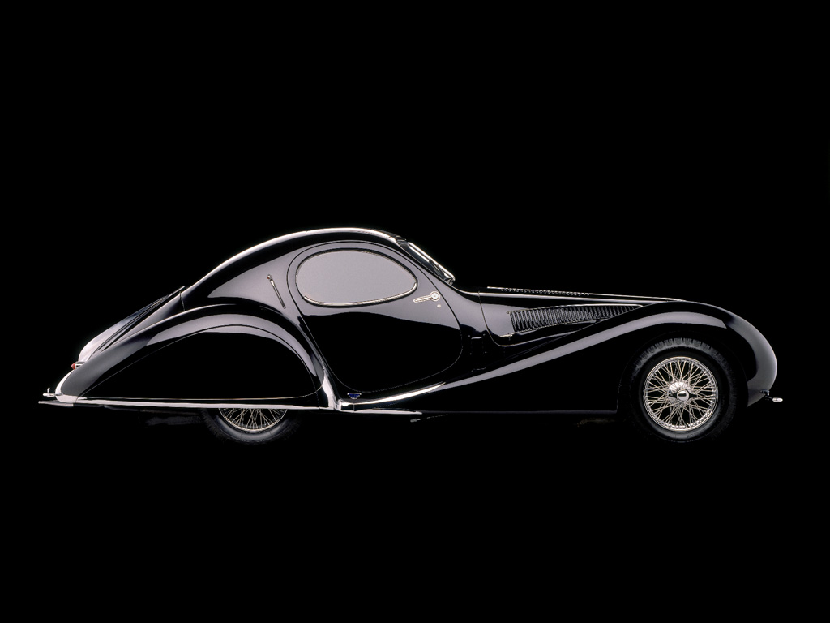
ROAD MARVELS
Extraordinary cars from before the war

Slide 2
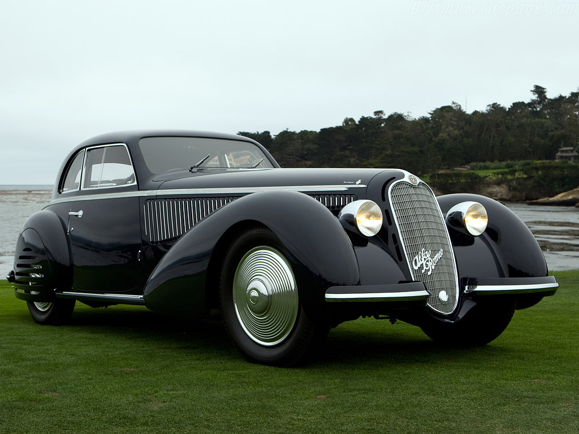
Alfa Romeo 8C 2900 B Corto Touring Berlinetta

Slide 3
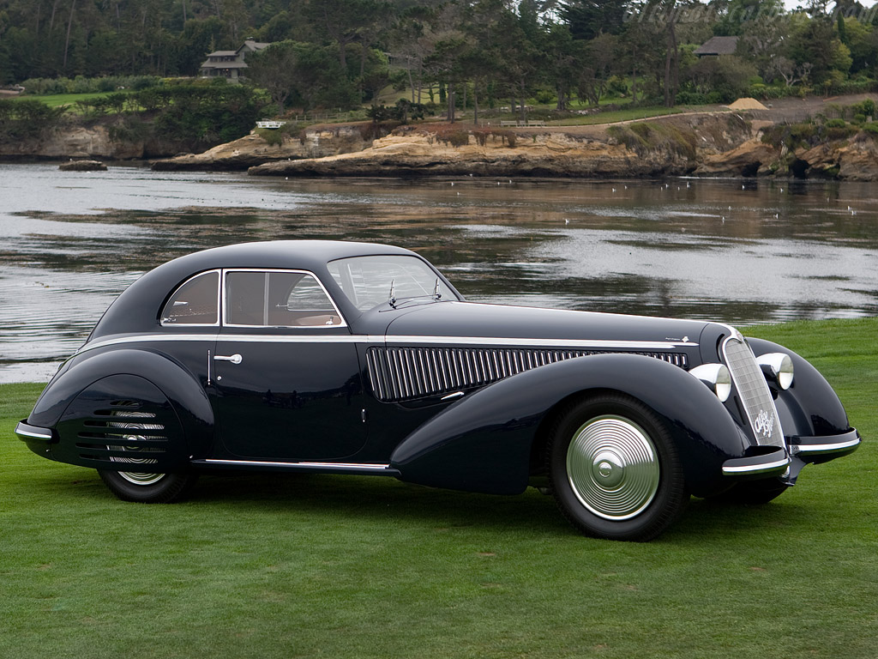
In line 8 cylinders 2,9 liters engine
Only 20 cars were built between 1937 abd 1939.
The model shown won the 2008 “Concours d'Elegance” at Pebble Beach.

Slide 4
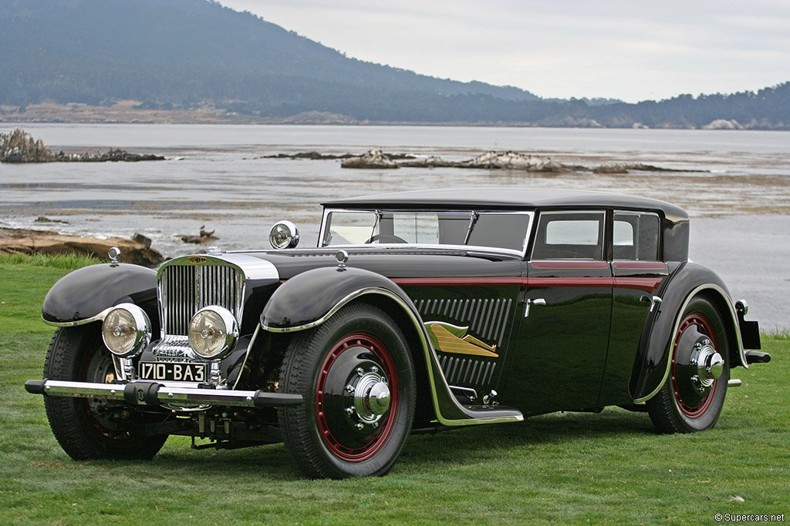
Bucciali TAV 8-32 Saoutchik 'Fleche d'Or' Berline

Slide 5
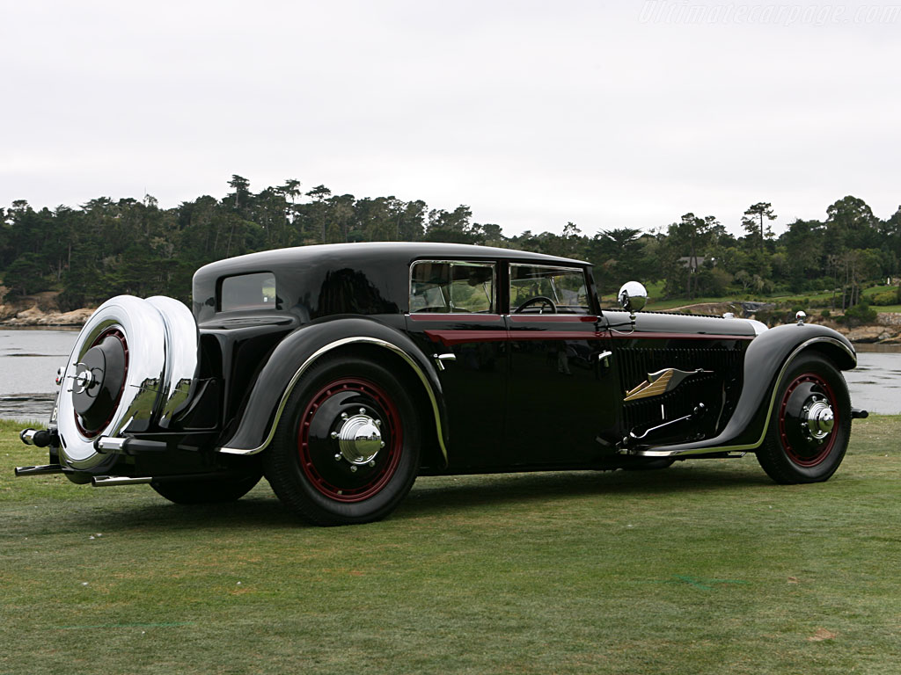
V12 engine of 4,9 liters.
Built in 1931.
One of the first front wheel drive.

Slide 6
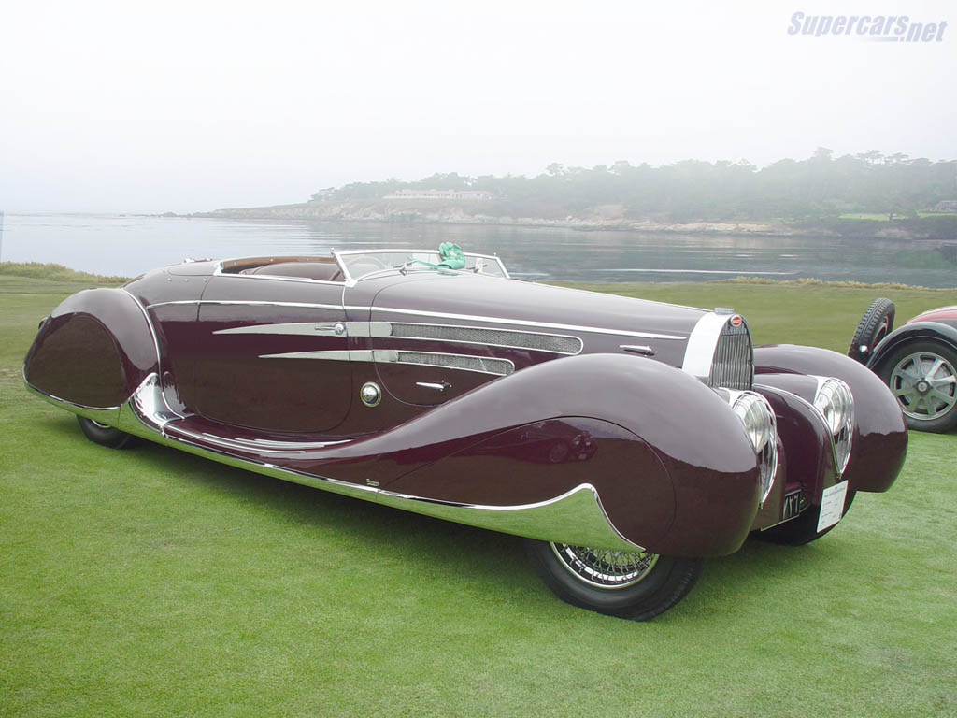
Bugatti Tipo 57C Van Vooren Cabriolet

Slide 7
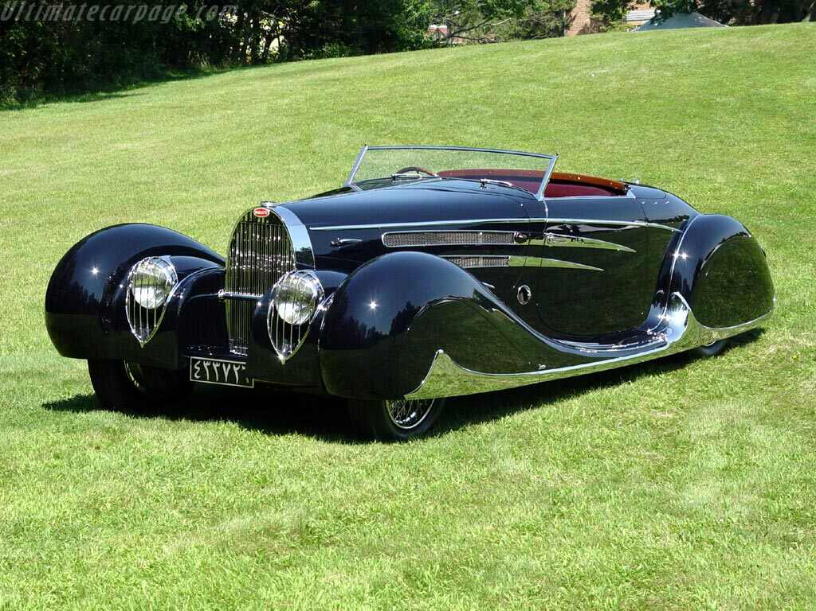
Inline 8 cylinder engine 3,3 liters
Unique car, built in1939.
Wedding gift to Xá from Persia from the government of France

Slide 8
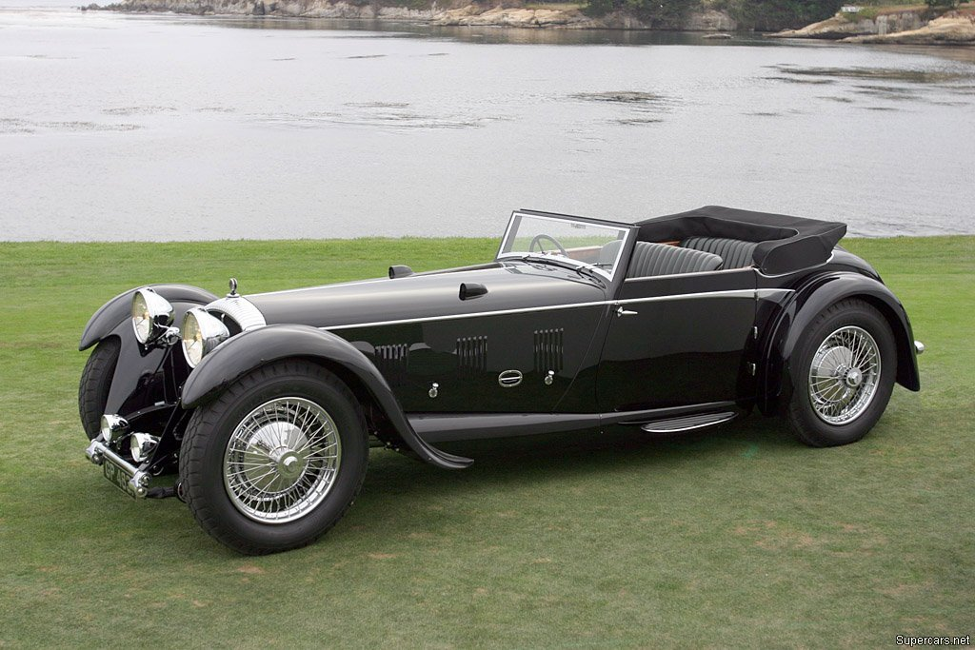
Daimler Double-Six 50 Corsica Drophead Coupé

Slide 9
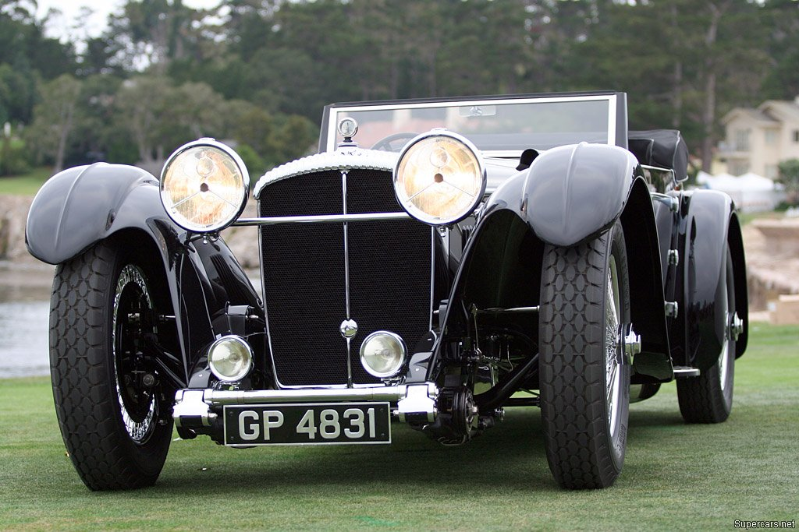
7,2 liters V12 engine. Unique car, built in 1931.

Slide 10
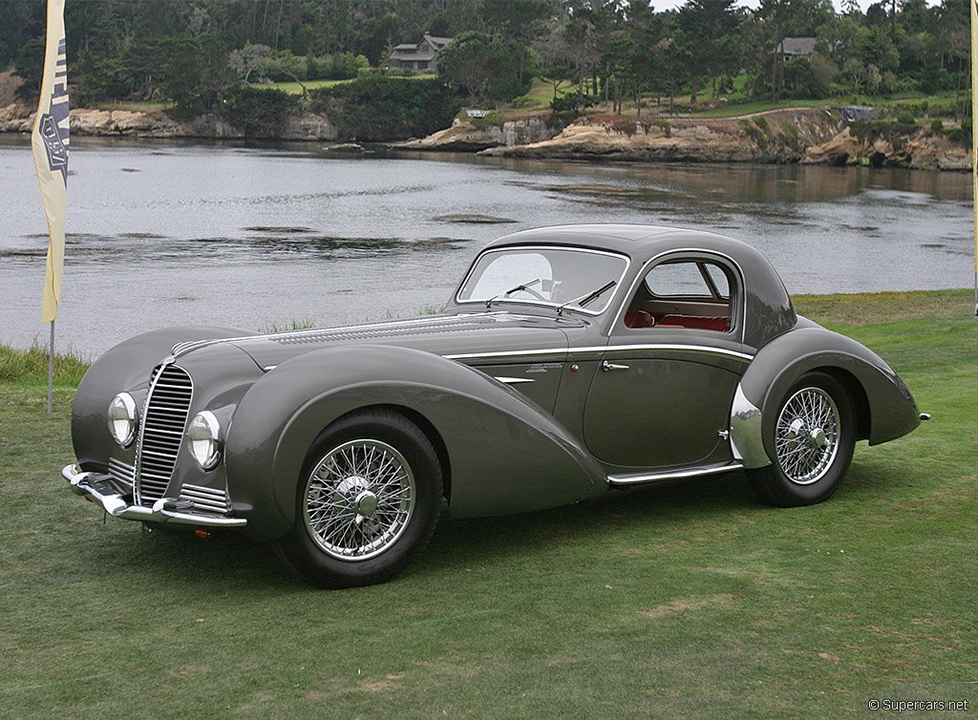
Delahaye 145 Chapron Coupe

Slide 11
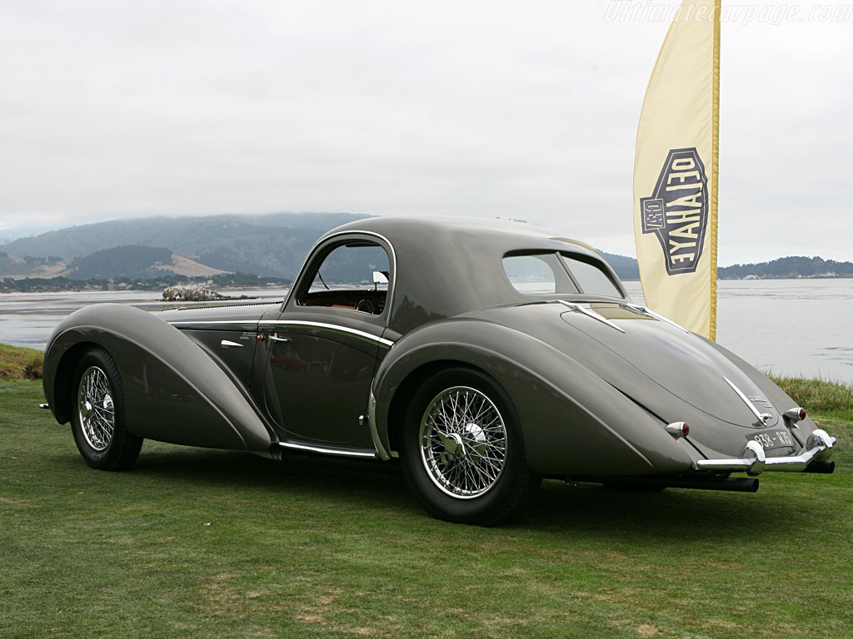
4,5 liters V12 engine
5 units were built between 1938 et 1946.

Slide 12
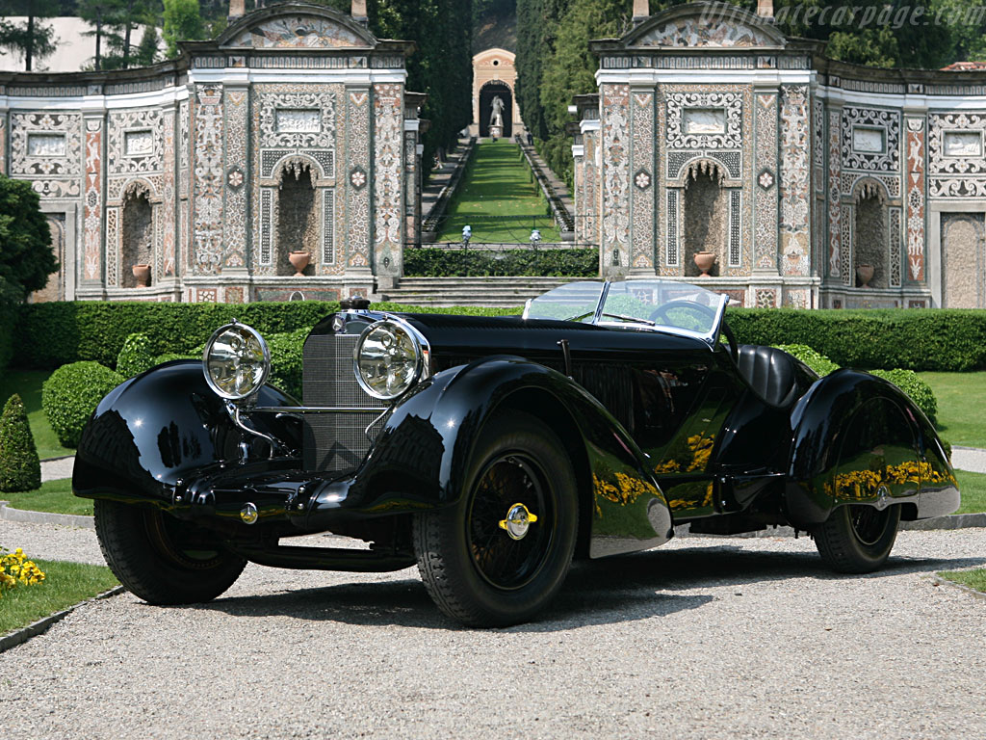
Mercedes-Benz 710 SSK Trossi Roadster

Slide 13
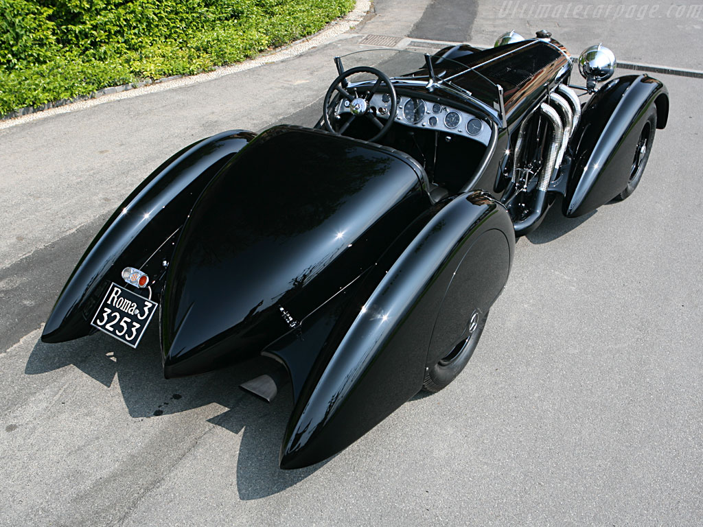
In line 7.1 liter 6 cylinder engine.
unique,
built in 1931.
Won the “concours d’élégance”
of Villa d'Este en 2007.

Slide 14
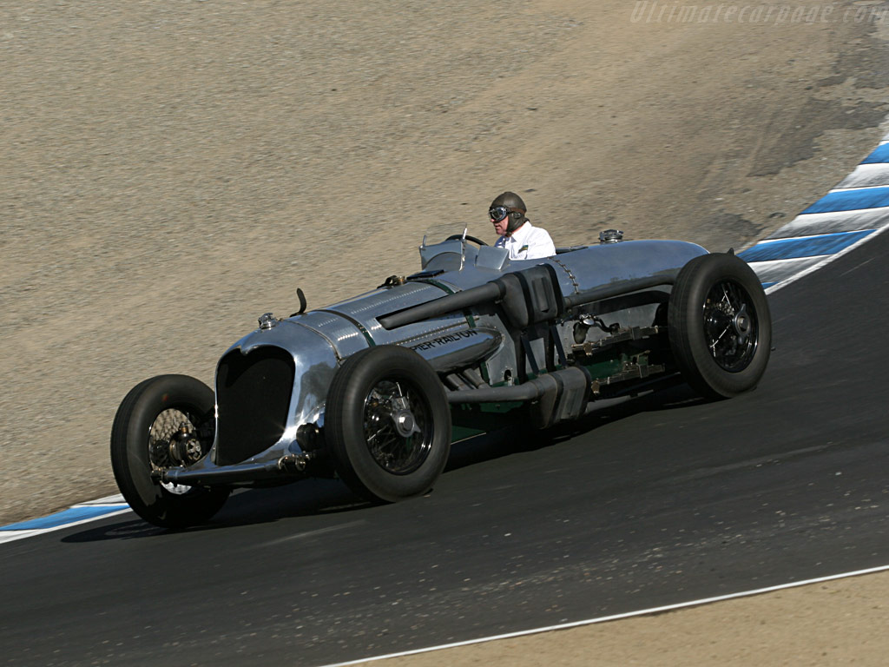
Napier-Railton Special

Slide 15
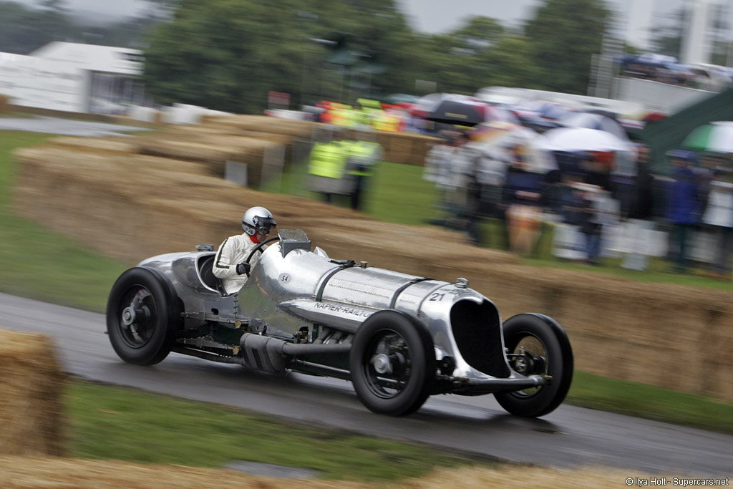
24 liters 12 cylinder aircraft engine. Power estimated at 600 HP.
One built in 1933.
Set 47 world speed records.

Slide 16
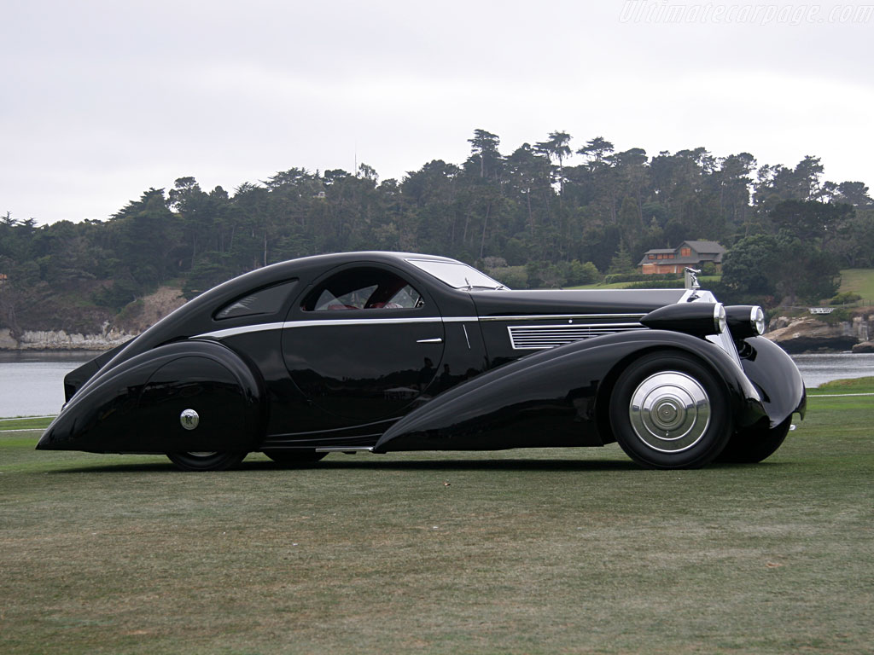
Rolls-Royce Phantom I Jonckheere Coupé

Slide 17
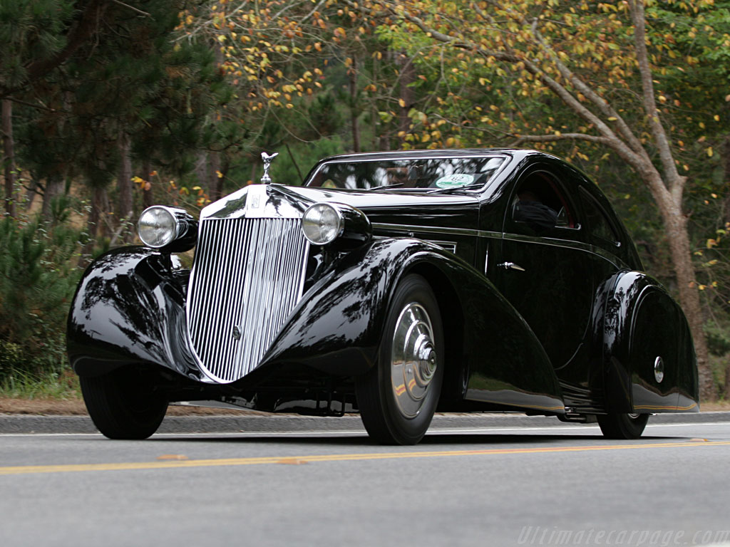
7,7 liters 6 cylinder in line .
One built in Belgium in the 30s. Bought at auction by a Japanese for 1,5 million US $ .

Slide 18
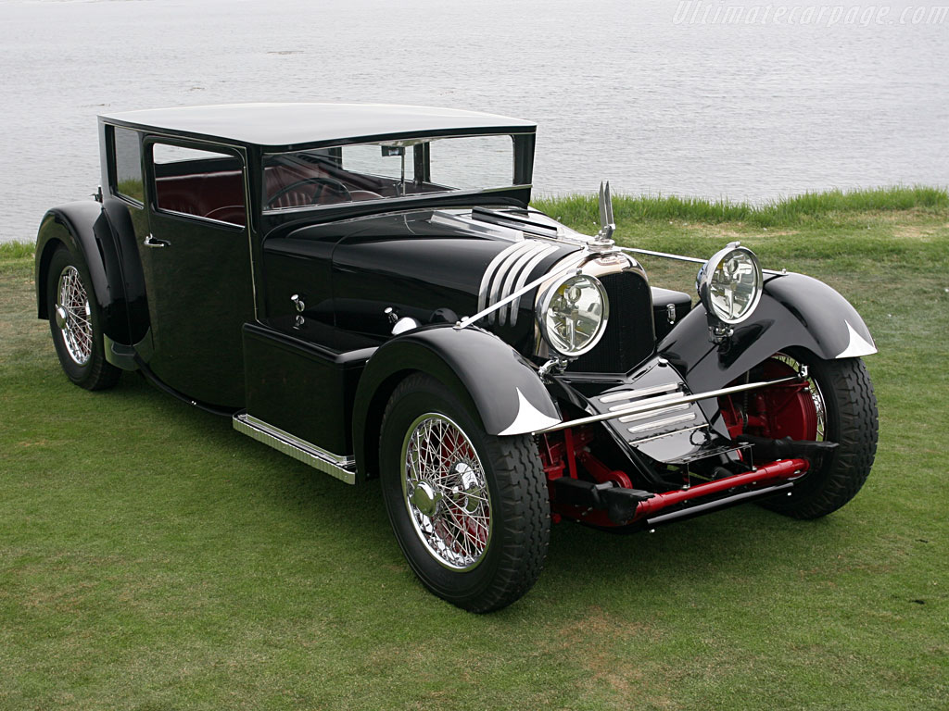
Voisin C20 'Mylord' Demi-Berline

Slide 19
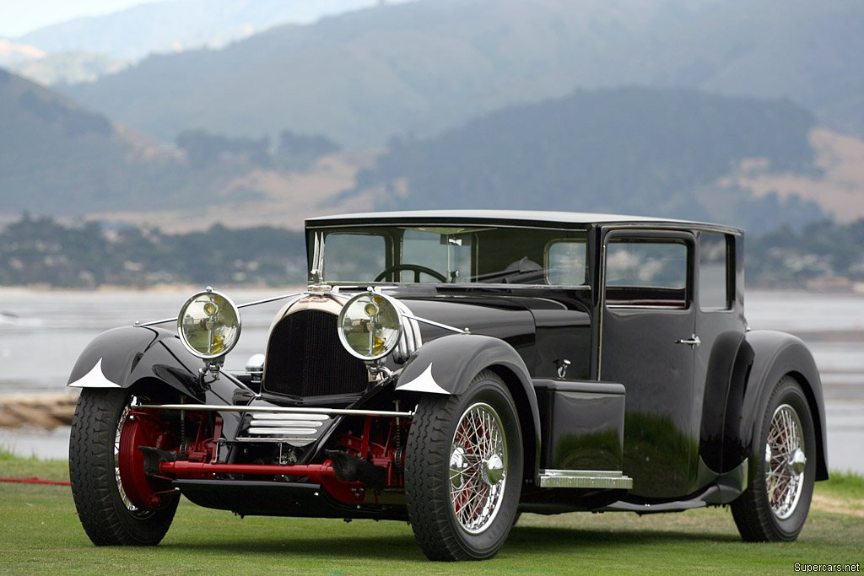
4.9 liter V12 engine.
One built in 1931.

Slide 20
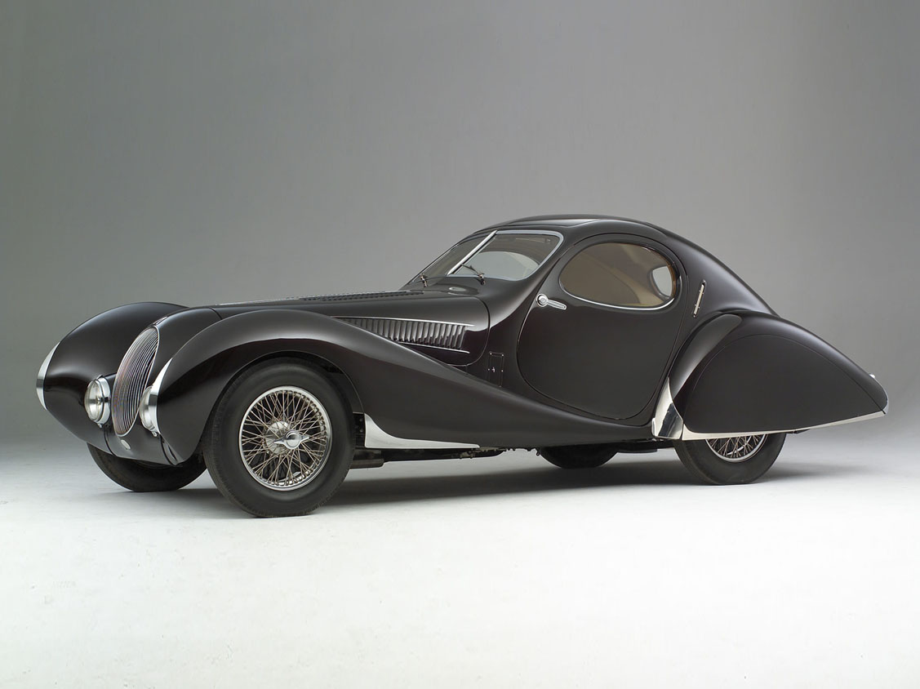
Talbot-Lago T150 C Figoni et Falaschi 'Goutte d'Eau'
4 liter 6 cylinder in line engine.
Only 16 units built.
Valued at 3 millions US$.

Slide 21
What craftsmen they were to create such jewels.
Have a super day!
Martial

